Slide 1
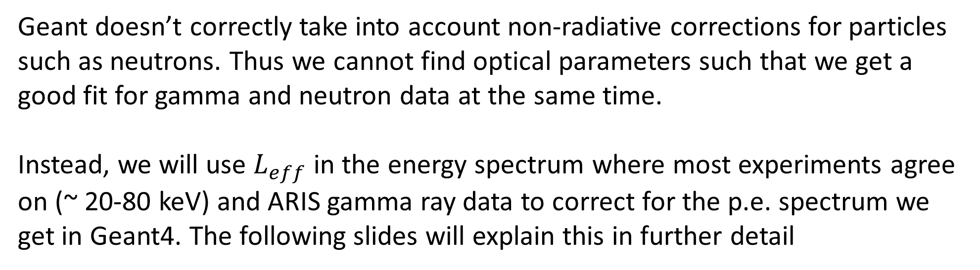
Moving forward
Geant doesn’t correctly take into account non-radiative corrections for particles such as neutrons. Thus we cannot find optical parameters such that we get a good fit for gamma and neutron data at the same time.
Instead, we will use $L_{eff}$ in the energy spectrum where most experiments agree on (~ 20-80 keV) and ARIS gamma ray data to correct for the p.e. spectrum we get in Geant4. The following slides will explain this in further detail

Slide 2
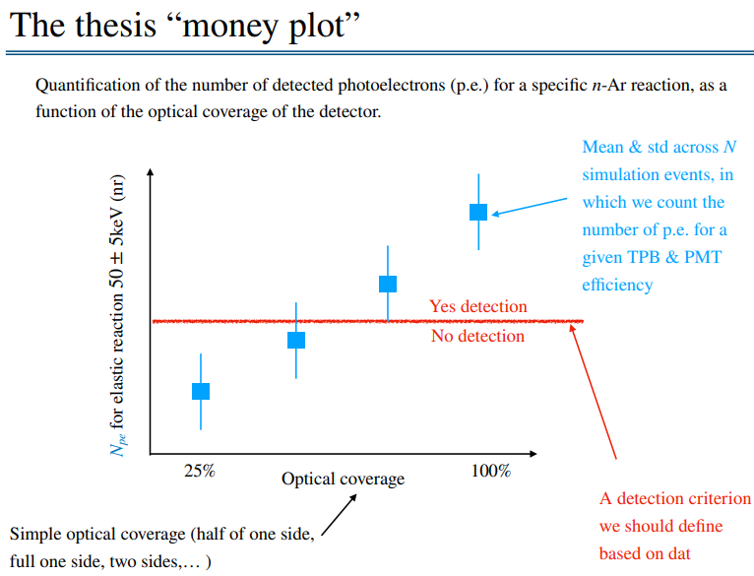

Slide 3
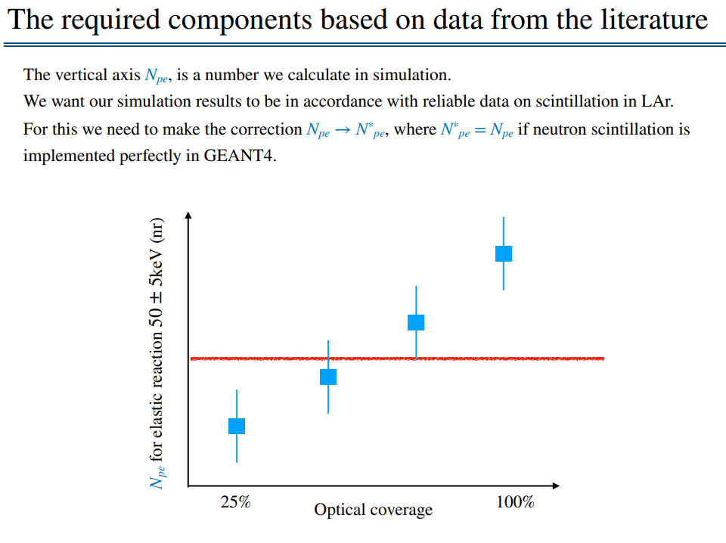

Slide 4
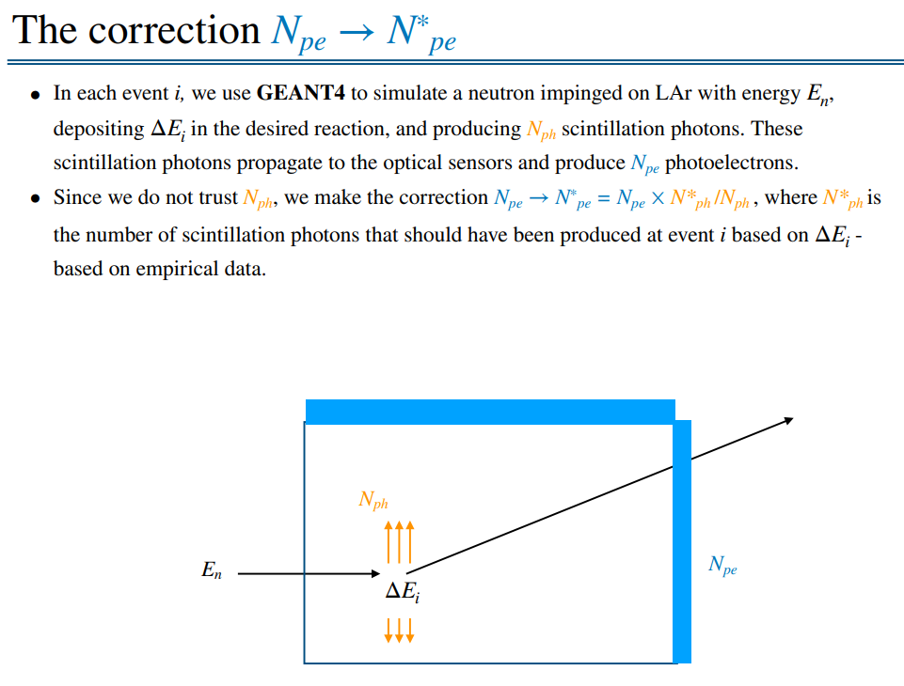
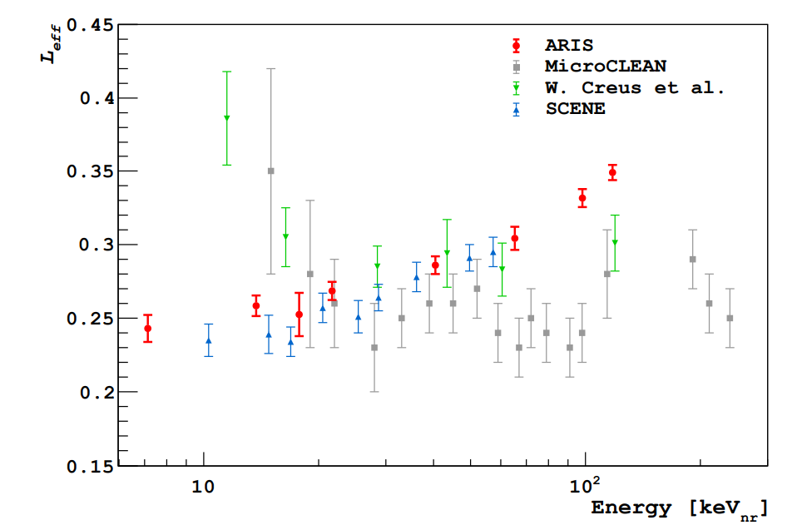
Empirical data showing the relative light yield from nuclear recoil to a reference gamma ray

Slide 5
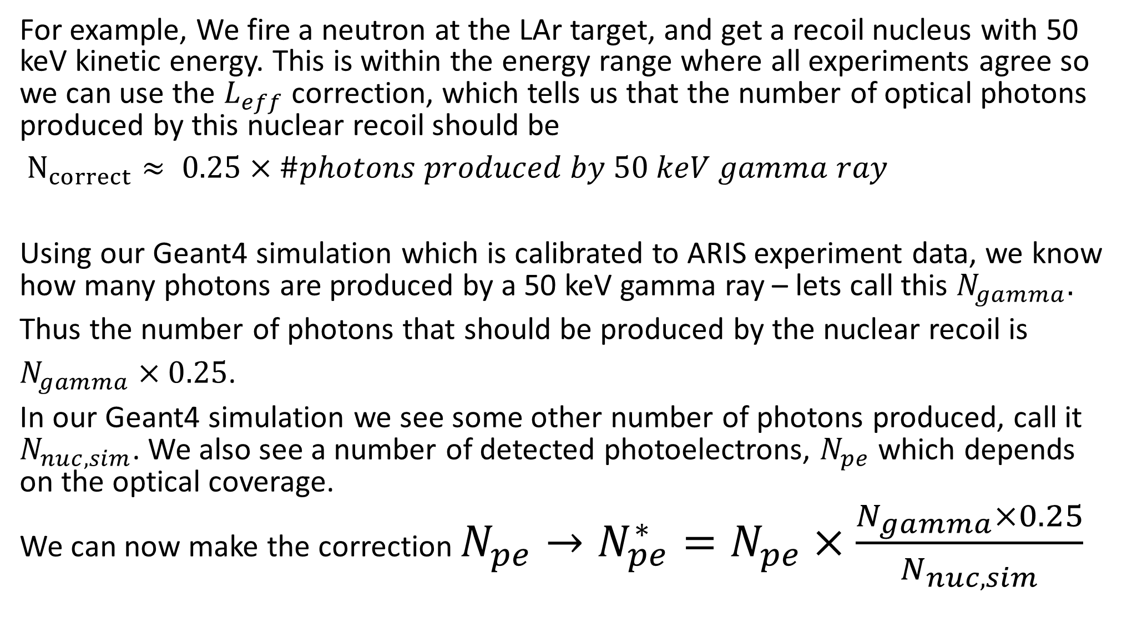
For example, We fire a neutron at the LAr target, and get a recoil nucleus with 50 keV kinetic energy. This is within the energy range where all experiments agree so we can use the $L_{eff}$ correction, which tells us that the number of optical photons produced by this nuclear recoil should be
$N_{correct}≈ 0.25×\#photons produced by 50 keV gamma ray$
Using our Geant4 simulation which is calibrated to ARIS experiment data, we know how many photons are produced by a 50 keV gamma ray – lets call this $N_{gamma}.$
Thus the number of photons that should be produced by the nuclear recoil is
$N_{gamma}×0.25$.
In our Geant4 simulation we see some other number of photons produced, call it $N_{nuc,sim}$. We also see a number of detected photoelectrons, $N_{pe}$ which depends on the optical coverage.
We can now make the correction $N_{pe}→N_{pe}^{∗}=N_{pe}×\frac{N_{gamma}×0.25}{N_{nuc,sim}}$

Slide 6
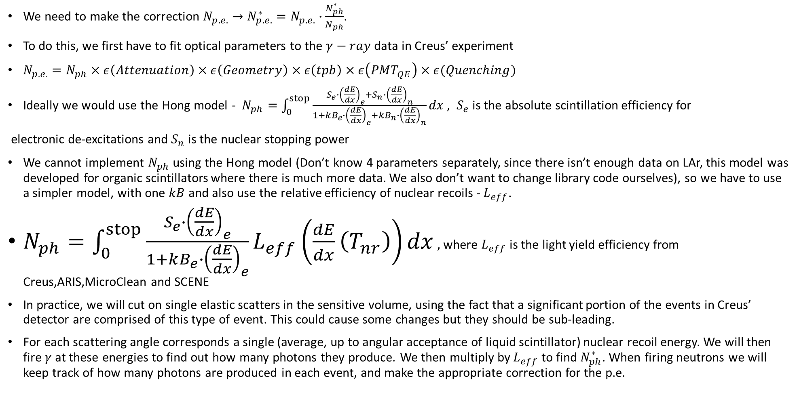
Testing on experiments
We need to make the correction $N_{p.e.}→N_{p.e.}^{∗}=N_{p.e.}∙\frac{N_{ph}^{∗}}{N_{ph}}$.
To do this, we first have to fit optical parameters to the $γ−ray$ data in Creus’ experiment
$N_{p.e.}=N_{ph}×ε\left(Attenuation\right)×ε\left(Geometry\right)×ε\left(tpb\right)×ε\left(PMT_{QE}\right)×ε(Quenching)$
Ideally we would use the Hong model - $N_{ph}=\int_{0}^{stop}{\frac{S_{e}∙{\left(\frac{dE}{dx}\right)}_{e}+S_{n}∙{\left(\frac{dE}{dx}\right)}_{n}}{1+kB_{e}∙{\left(\frac{dE}{dx}\right)}_{e}+kB_{n}∙{\left(\frac{dE}{dx}\right)}_{n}}dx}$ , $S_{e}$ is the absolute scintillation efficiency for
electronic de-excitations and $S_{n}$ is the nuclear stopping power
We cannot implement $N_{ph}$ using the Hong model (Don’t know 4 parameters separately, since there isn’t enough data on LAr, this model was developed for organic scintillators where there is much more data. We also don’t want to change library code ourselves), so we have to use a simpler model, with one $kB$ and also use the relative efficiency of nuclear recoils - $L_{eff}$.
$N_{ph}=\int_{0}^{stop}{\frac{S_{e}∙{\left(\frac{dE}{dx}\right)}_{e}}{1+kB_{e}∙{\left(\frac{dE}{dx}\right)}_{e}}L_{eff}\left(\frac{dE}{dx}\left(T_{nr}\right)\right)dx}$ , where $L_{eff}$ is the light yield efficiency from Creus,ARIS,MicroClean and SCENE
In practice, we will cut on single elastic scatters in the sensitive volume, using the fact that a significant portion of the events in Creus’ detector are comprised of this type of event. This could cause some changes but they should be sub-leading.
For each scattering angle corresponds a single (average, up to angular acceptance of liquid scintillator) nuclear recoil energy. We will then fire $γ$ at these energies to find out how many photons they produce. We then multiply by $L_{eff}$ to find $N_{ph}^{∗}$. When firing neutrons we will keep track of how many photons are produced in each event, and make the appropriate correction for the p.e.

Slide 7
